Slide 1
POWER BI PROJECT

Slide 2
PERFORMED BY
Surajit Gharami (AF0406773)

Slide 3
PROBLEM STATEMENT
We have the sales data of a restaurant of the last 15 days. It consists of details on the time of customer visit, type of orders, the amount spent against the orders by the customers, etc.
The restaurant provides a variety of menus.
However, the management wants to take action on cost-cutting and improving the profit.
Analyze the data and help them by providing actionable insights with the visual representation of data analysis to justify your suggestions.

Slide 4
QUESTION 1
Which item is sold the most and which item is sold the least?
Solution:
Most sold item : Chicken Biryani
Least sold item: Veg Biryani, Cold Coffee

Slide 5
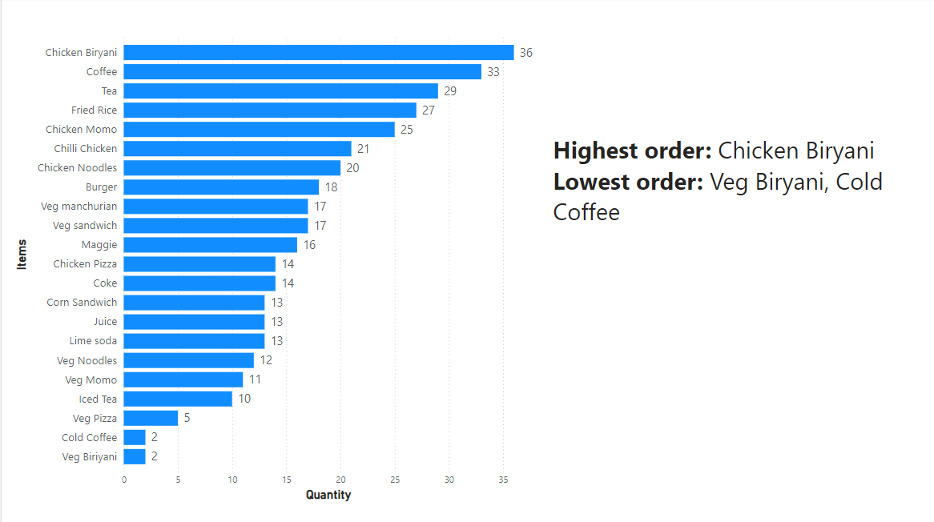
QUESTION 1

Slide 6
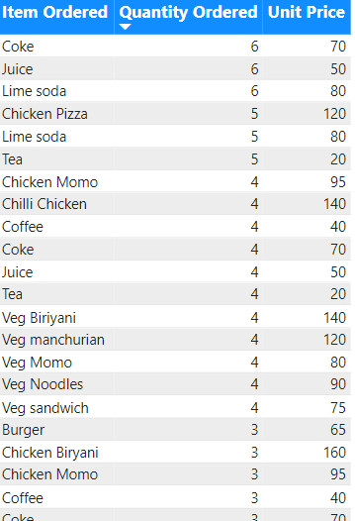
QUESTION 2
Are more units ordered against lower-priced items or higher-priced items in a single order?
Solution:
In a single order more units are ordered against lower-priced items.
Items with more units ordered in a single order are:
Coke : Rs. 70
Juice: Rs. 50
Lime Soda: Rs. 80
Most order placed at unit price Rs. 90 and the order count is 44

Slide 7
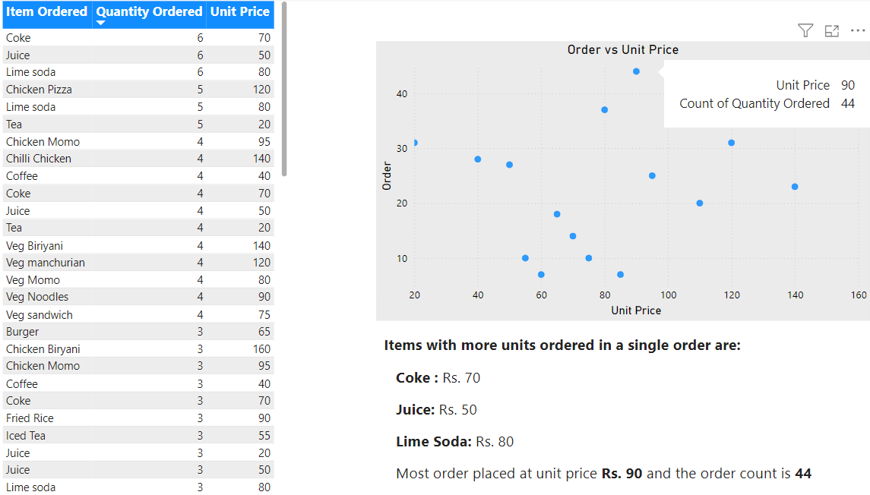
QUESTION 2

Slide 8
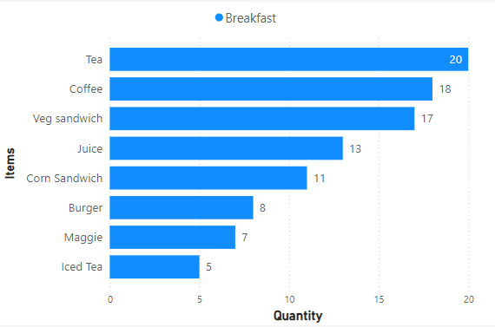
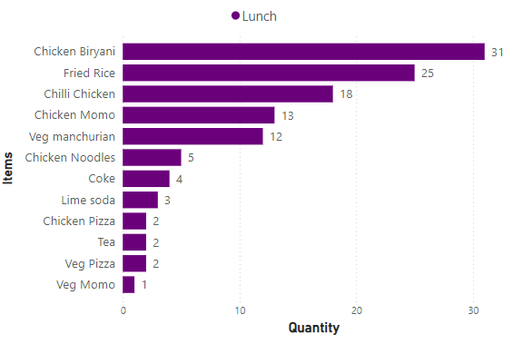
QUESTION 3
What items are sold more and what items are sold less in what type of meal?
Breakfast
Top selling: Tea, Coffee, Veg sandwich
Less selling: Iced Tea, Maggie, Burger
Lunch
Top selling: Chicken Biryani, Fried Rice, Chilli Chicken
Less selling: Veg Momo, Veg Pizza, Tea

Slide 9
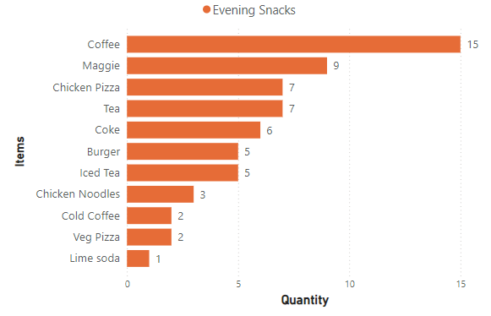
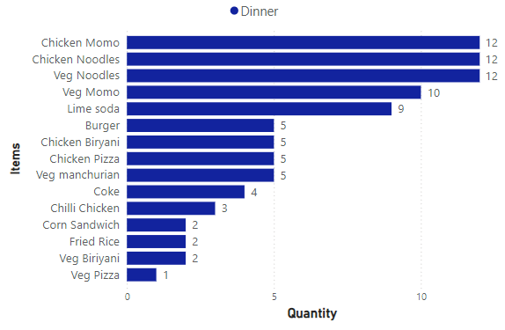
QUESTION 3
Evening Snacks
Top selling: Coffee, Maggie, Chicken Pizza
Less selling: Lime Soda, Veg Pizza, Cold Coffee
Dinner
Top selling: Chicken Momo, Chicken Noodles, Veg Noodles
Less selling: Veg Pizza, Veg Biryani, Fried Rice

Slide 10
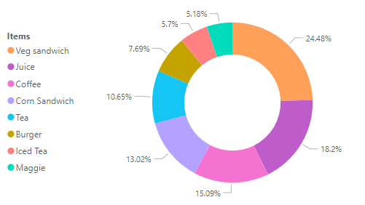
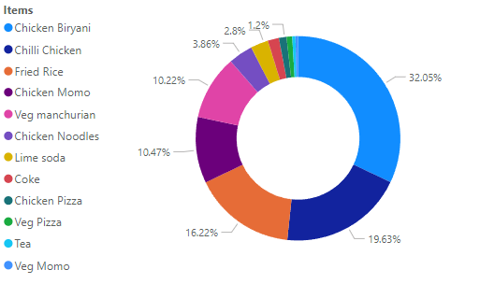
QUESTION 4
Sale of which items in what type of meal generate a greater amount of sales?
Breakfast
Top selling: Veg sandwich, Juice, Coffee
Less selling: Maggie, Iced Tea, Burger
Lunch
Top selling: Chicken Biryani, Chilli Chicken, Fried Rice
Less selling: Veg Momo, Tea, Veg Pizza

Slide 11
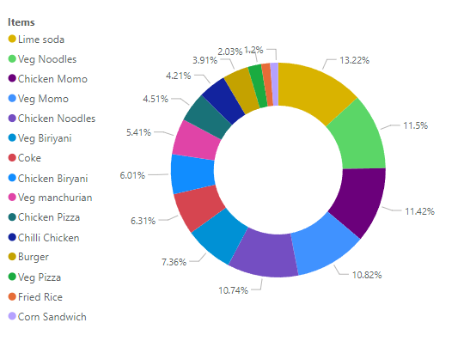
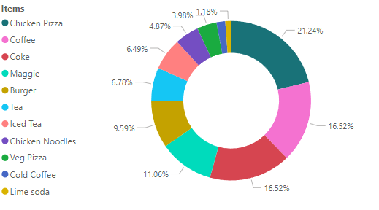
QUESTION 4
Evening Snacks
Top selling: Chicken Pizza, Coffee, Coke
Less selling: Lime Soda, Cold Coffee, Veg Pizza
Dinner
Top selling: Lime Soda, Veg Noodles, Chicken Momo
Less selling: Corn Sandwich, Fried Rice, Veg Pizza

Slide 12
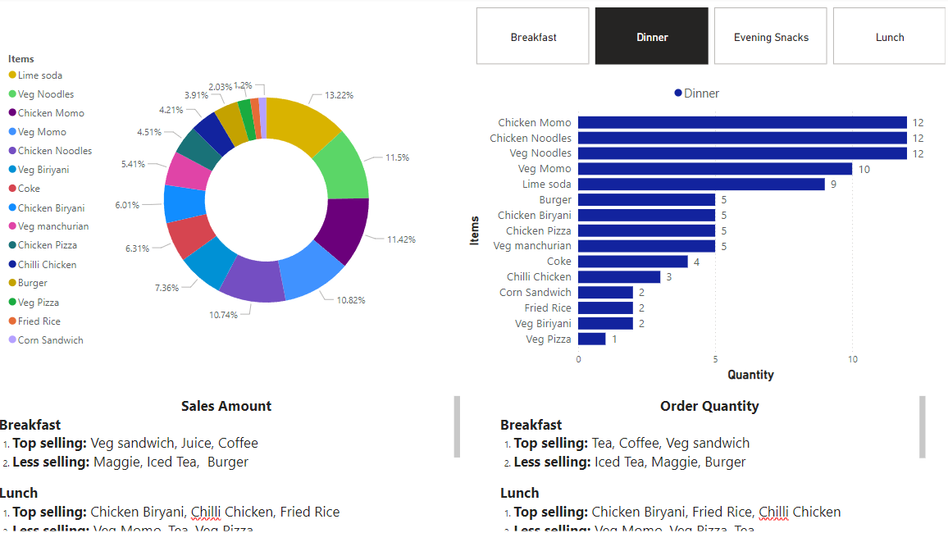
QUESTION 4

Slide 13
QUESTION 5
Should the company continue offering all items at different times of the day?
Solution:
After the data analysis it can be said that it will be profitable to not offer all items at different times of the day.
Items ordered by customers in at least 3 types: Tea, Coke, Lime Soda, Burger, Chicken Noodles, Chicken Pizza, Veg Pizza,
Items being ordered in more than one meal type: Coffee, Chicken Biryani, Fried Rice, Chili Chicken, Veg Manchurian, Maggie, Veg Momo, Iced Tea, Corn Sandwich

Slide 14
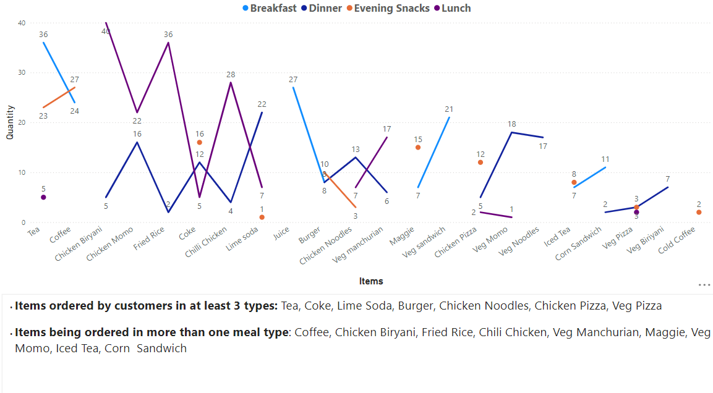
QUESTION 5

Slide 15
ACTIONABLE INSIGHTS
Menu Optimization: Focus on promoting and optimizing the preparation and presentation of top-selling items like Chicken Biryani, Fried Rice, and Chili Chicken.
Promotional Strategies: Consider bundling less-selling items with popular items in promotional deals to increase their visibility and sales.
Customer Preferences: Use sales data to tailor menu offerings and promotional efforts to better align with customer preferences across different meal types.
Cross-Selling Opportunities: Leverage items like Tea, Coffee, and Veg Pizza that are ordered across multiple meal types to create cross-selling opportunities and increase average order value.

Slide 16
THANK YOU

